Slide 1

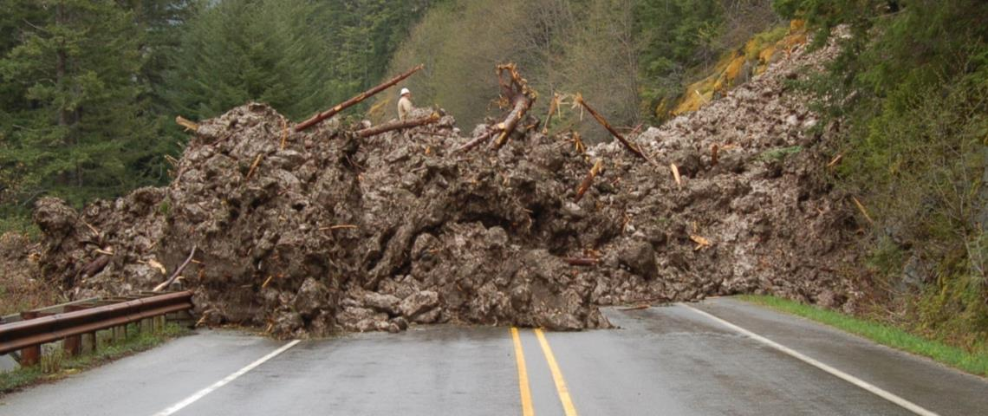
Landslide Hazard Modeling in the Skagit Basin
Seattle City Light and University of Washington

Slide 2
Landslide Hazard Study: Objectives
Identify probability of landslide initiation using hydrologic model results for historical and future climatology
Compare current hazards with future hazards
Assess sensitivity of landslide hazard prediction for
Saturated soil variability
Post-fire vegetation dynamics

Slide 3
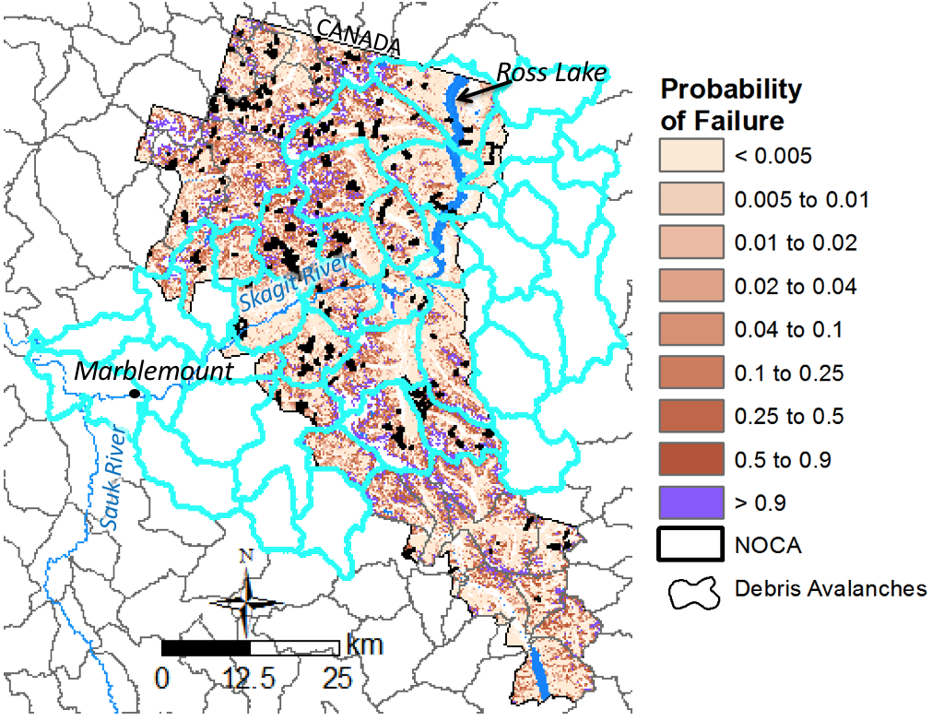
STUDY AREA
Skagit Basin from Canada to confluence with Sauk River (cyan watersheds)
Notes:
Change to show outline of Skagit to Sauk

Slide 4
TEAM
Christina Bandaragoda
PI & Hydrology technical lead
Erkan Istanbulluoglu, Guillaume Mauger, Crystal Raymond
Project Advisory Committee
Ronda Strauch
Landslide technical lead
Dan Miller (Consultant)
Landslide technical advisor and QA/QC
Freshwater-eScience research scientist
Landlab component code update
DHSVM input/output coding
Sensitivity analysis scenario building
PhD Student Support
Sai Nudurupati -Landlab support
Jeff Keck – Landsliding & PREEVENTS integration

Slide 5
DELIVERABLES
Groundwater depth from DHSVM run at 150-m resolution from 1925 – 2099 based on 2 GCM and emission scenarios (MACA)
Landscape characteristics, including soil depth, slope, and cohesion
Maps of landslide hazard at 30-m resolution, including historic and future
Sensitivity analyses

Slide 6
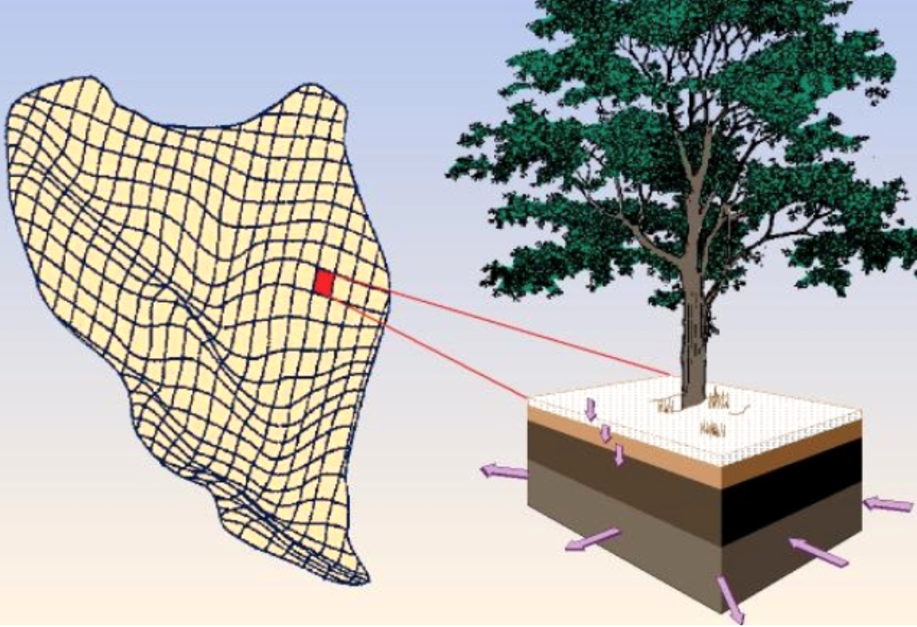


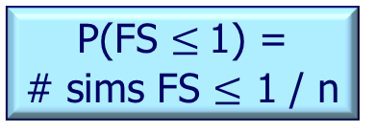
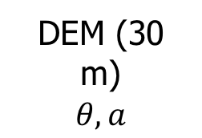
Methodology - Modeling Factor of Safety Model - Monte Carlo Simulations
Gridded Climate Data (Temp. & Precip)
Parameter Uncertainty
DHSVM Hydrologic Model 150 m
eCDF
Triangle Distributions
Prob.
Freq
Recharge
C, T, hs, and $∅$
Monte Carlo Simulation
Calculate FS n times
Flow Routing
DEM (30 m)
$$θ, a$$
P(FS ≤ 1) = # sims FS $≤$ 1 / n

Slide 7
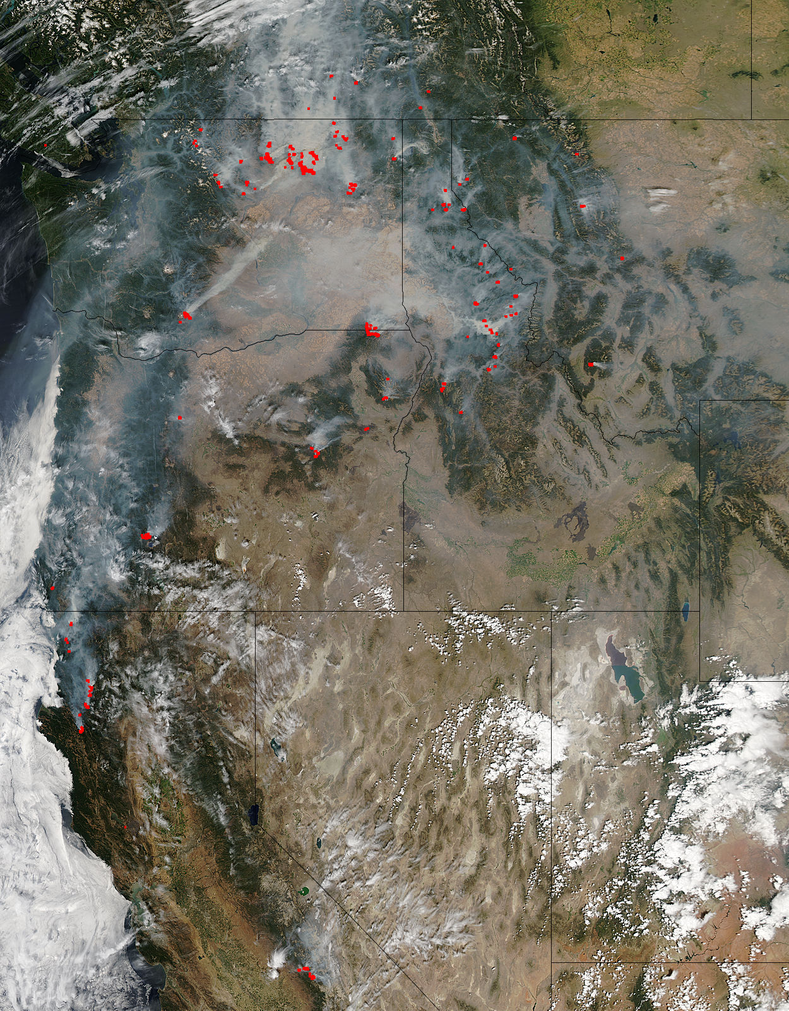
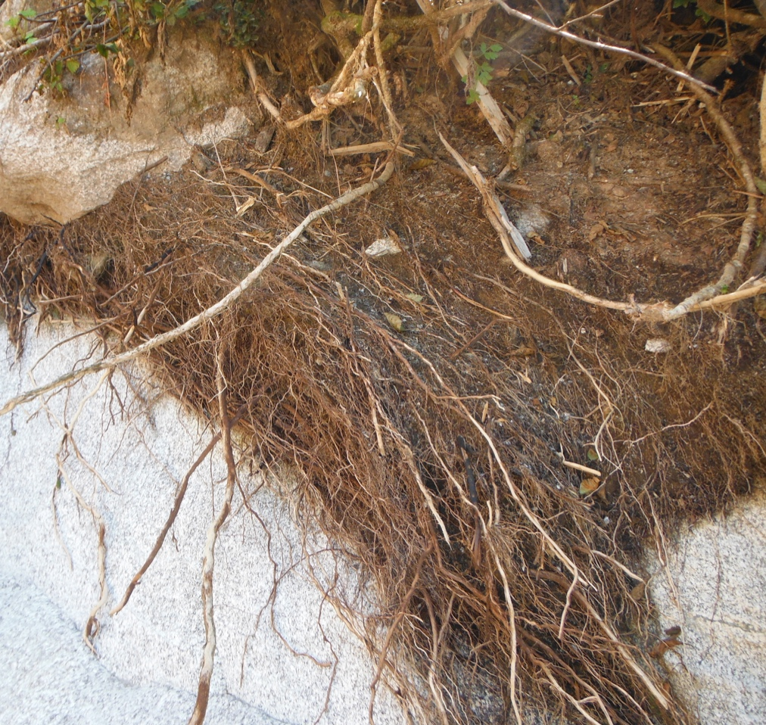
Fire
Project area burned 3.8X by 2040s (west Cascades)*
Loss of root cohesion
Fires – August 2015 as seen from NASA’s Aqua-Modis
*Littell et al. 2010
Notes:
Warmer temperatures, drier summers, and less snowpack
Collapses and increases soil density, creates water repellency, reduces infiltration leading to more runoff, plus kills roots that decay over time and reduce soil strength
Great! …more erosion, landslides, and sediment

Slide 8
SCHEDULE
Spring: landscape characteristics and DHSVM model results
Summer: historic and future landslide hazard
Autumn: sensitivity analyses to subsurface flow and fire
Done June 2019

Slide 9
Future work
Expand analyses to rest of SCL transmission lines
Use hazard to study sediment transport and deposition hazards
Assess ‘hotspot’ hazards & risks to infrastructure

